Slide 1
Excitation and Ionization Energies of Helium and Mercury Frank – Hertz Experiment
Lee Allers

Slide 2
Outline
Background
Method
Data and Analysis
Discussion
Conclusion

Slide 3
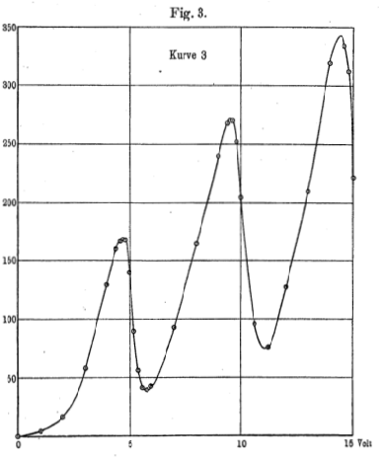
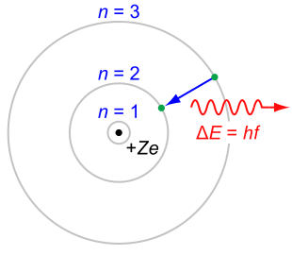
Background
Bohr Model – Neils Bohr, 1913
In 1914, James Franck and Gustav Hertz published the results of an experiment which provided strong evidence that Bohr’s model of atoms with quantized energy levels was correct. Of course this happened indirectly because neither Franck nor Hertz were aware of Bohr’s theory!
Frank-Hertz original data shows electrons losing 4.9 eV per collision with mercury atoms.
Bohr model of the hydrogen atom where a negatively charged electron encircles a positively charged nucleus and where an electron jumps between orbits. This transition is accompanied by an emitted or absorbed amount of electromagnetic energy.
Original data of excitation peaks of mercury

Slide 4
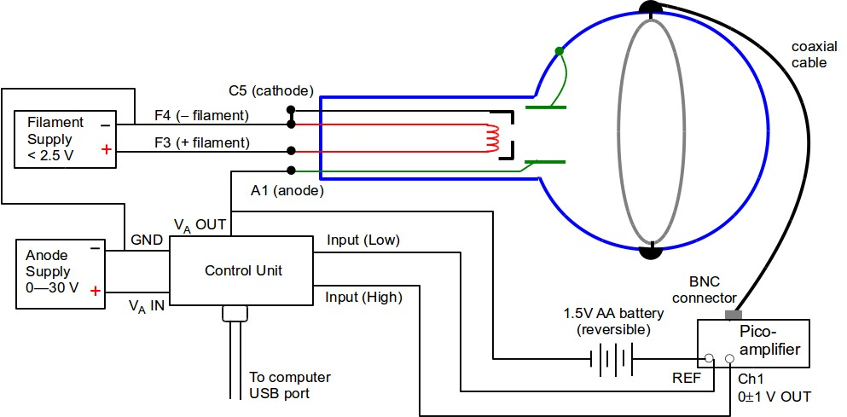
Methods (Helium)
The Filament Supply supplys a current that heats the filament ( in red) and produces a thermionic emission of electrons.
The Anode Supply is set to a maximum voltage which is constant (~30V) and allows the control unit to provide a Voltage out to the bulb, by increasing the voltage in steps, controlled by Labview.

Slide 5
Methods (Helium)
By making the collector a few volts positive with respect to the anode an electron that has lost energy will be attracted to it and collected. Thus when the mean energy of the electron stream is sufficient to excite helium atoms, the population of low energy electrons will increase significantly to produce in the collector a measurable current with little or no contribution from the main stream.
As the accelerating voltage is increased the excitation at first increases and then falls away until another, higher energy, excitation occurs with a further increase in the low energy electron current.

Slide 6
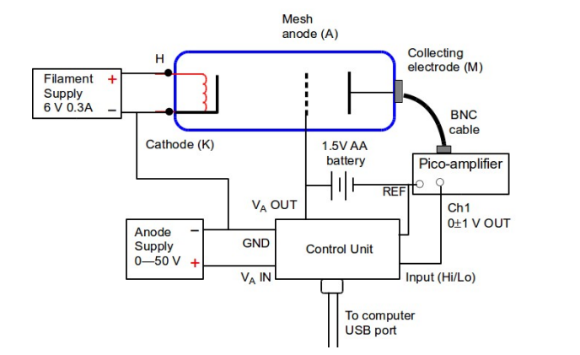
Methods (Mercury)
The collector electrode (M) monitors current due to electrons passing through the mesh anode (A)
The battery provides a decelerating potential that slows electrons before hitting the collector. Any electron(s) without enough energy, due to inelastic collisions, cannot overcome this potential.

Slide 7
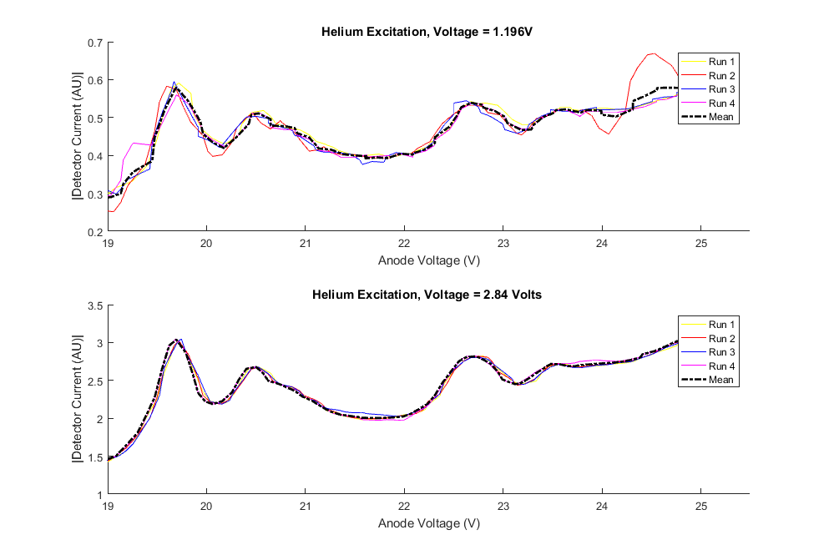
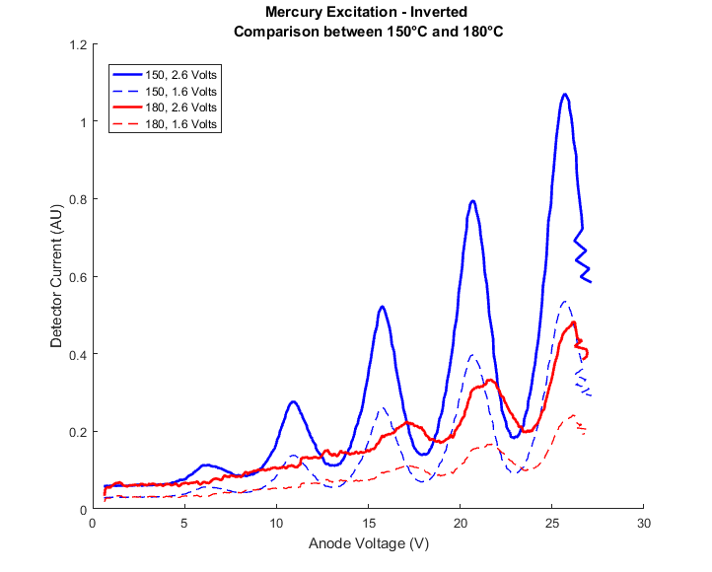
Data Analysis
Raw data for He
Raw data for Hg

Slide 8
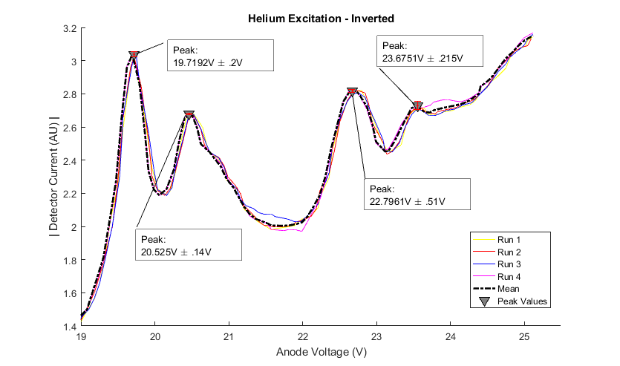
Helium ( 2.84V Anode Supply)
From these plots we find the peak values, peak prominence, and the full width half maximum values.
Measured Value | Accepted Value | % Difference
19.7 eV | 19.8 eV | .51 %
20.525 eV | 20.9 eV | 1.79 %
22.79 eV | 22.9 eV | .48 %
23.67 eV | 23.21 eV | 1.94 %
FWHM
4.547
5.98
5.8411
2.0566

Slide 9
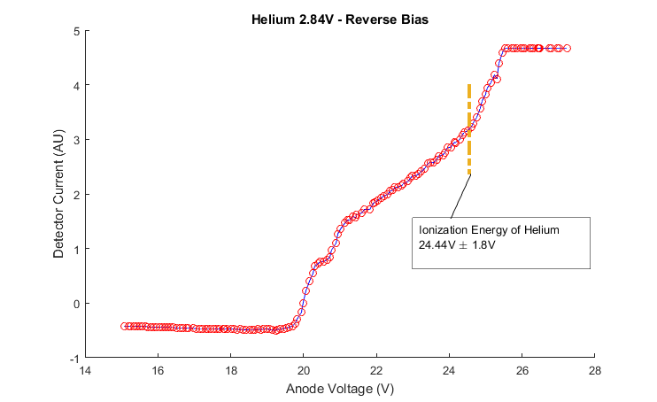
Helium ( 2.84V Anode Supply)
From the plot of the reverse bias data, we can clearly see where the excitation energy ends and Ionization begins, as show by a sharp increase in the slope of the Current/Voltage.
Accepted value, 24.6eV

Slide 10
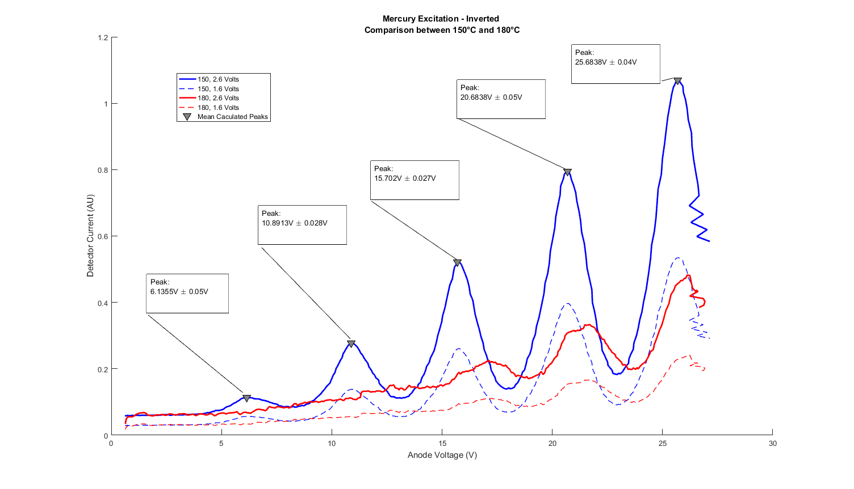
Mercury ( at 150˚C, 2.6V Anode Supply )
By taking the difference in peak values, we find a relation between the supplied voltage and excitation energy of Mercury.
From this peak value, we find the x value of the first peak and subtract that difference to find the work function of the mercury cathode. [ 6.135 ± 0.1407 - 4.849 ± 0.1178 ]
Measured Value | Accepted Value | % Difference
4.849 ± 0.1178 eV | 4.9 eV | .82 %
Work Function
1.28 eV ± 0.2578 eV

Slide 11
Conclusion
From this data, we successfully showed the existence of excited states in Helium and Mercury atoms. By bombarding Helium and Mercury atoms we’ve verified that atomic systems have discrete energy levels as predicted by Niels Bohr

